Slide 1
Territory and Quota Planning
Application on Polaris
Functional Overview
Application Version 3.0.0
Last Updated December 2025

Slide 2
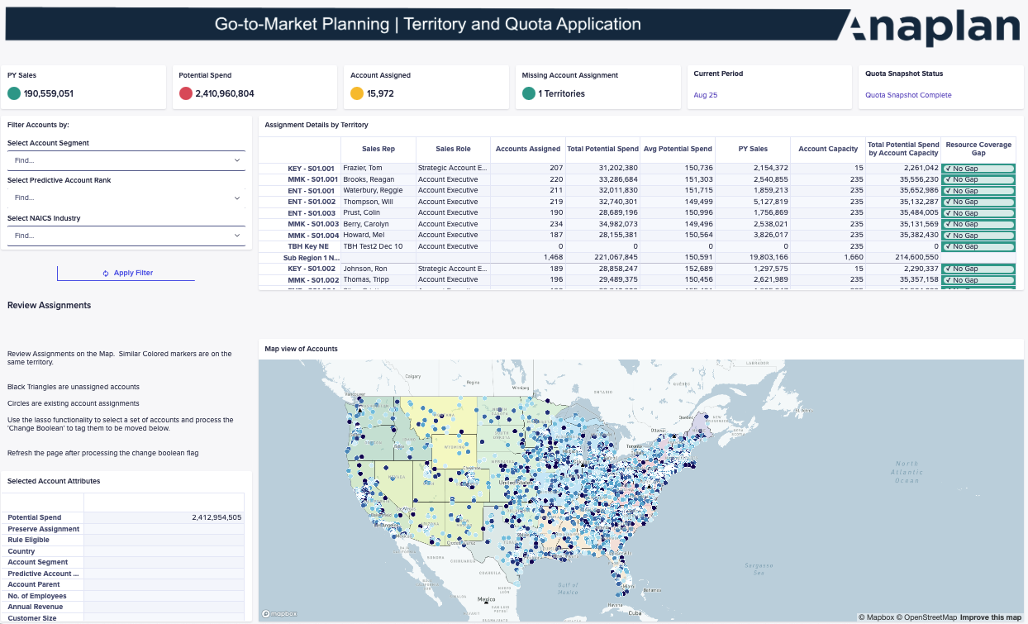
Territory and Quota Planning Application
OVERVIEW
Anaplan’s Territory and Quota Planning Application on Polaris helps organizations accelerate revenue, improve sales productivity, and increase team motivation by driving fair, data-driven territory and quota decisions.
KEY CAPABILITIES
Manage planning year and current year separately
Compare scenarios for all planning year decisions
Carve territories by postal code with geo-mapping boundary support
Assign quotas using role-based and hierarchical logic with ramping, seasonality, and approval workflows
Apply flexible multi-territory and multi-resource assignments
Model account-to-territory assignments and splits
Manage complex 1:many resource-to-territory assignments with effective dates for transitions
Notes:
Summary

Slide 3

Anaplan Territory and Quota Planning Application
Out-of-the-box
Target Allocations
Input, adjust, override, and lock targets using top-down and bottom-up approaches, supported by dynamic advanced approval workflows, and final roll-up alignment.
Key Benefits:
Align territories and quotas using historical data and new forecasting application data.
Adapt sales plans with dynamic, scenario-based modeling, available for all planning year features.
Improve coverage with flexible resource assignments, supporting 1:many and many:1 resource assignments.
Assign quotas by role with ramping and seasonal flexibility, managing planning and current years concurrently.
Streamline workflows with approvals and effective dating, utilizing advanced top-down approval workflows.
Compare what-if scenarios to guide decisions, territory hierarchy changes and 1:many account splits.
Account-to-Territory Assignment
Model account redistribution scenarios, supporting 1:many account assignments with split logic, and plan geographically with zip code mapping.
Rep-to-Territory Assignment
Assign sales teams, overlays, and managers by role, supporting 1:many and many:1 resource assignments, and create hierarchies from sales relationships.
Quota Assignment
Assign and allocate flexible quotas using role-based, ramping, or seasonal factors. Compare top-down vs. bottom-up targets and finalize with approvals, managing the planning year and current year concurrently.
Scenario Planning
Build dynamic, driver-based sales plans by segment, product, or role. Model and compare full-year projections, with what-if scenarios available for all planning functionality.
Notes:
Align territories and quotas using historical, forecasted, and forecasting app data.
Adapt sales plans with dynamic, scenario-based modeling, available across all planning year functionality.
Improve coverage with flexible rep assignments and geo-planning, including 1:many and many:1 resource assignments (rep, overlay, manager).
Assign quotas by role with ramping and seasonal flexibility, managing both planning and current years simultaneously.
Streamline workflows with approvals and effective dating, now featuring advanced workflows for top-down approvals.
Compare what-if scenarios to guide smarter, faster decisions, supporting changes to the planning territory hierarchy and 1:many account splits.

Slide 4
Anaplan Territory and Quota Planning Application
Out-of-the-box
Target Allocations
Input, adjust, override, and lock targets using top-down and bottom-up approaches, now featuring advanced workflows for top-down approvals.
Key Benefits:
Align territories and quotas using historical data and new forecasting application data.
Adapt sales plans with dynamic, scenario-based modeling, available for all planning year features.
Improve coverage with flexible resource assignments, supporting 1:many and many:1 resource assignments.
Assign quotas by role with ramping and seasonal flexibility, managing planning and current years concurrently.
Streamline workflows with approvals and effective dating, utilizing advanced top-down approval workflows.
Compare what-if scenarios to guide decisions, territory hierarchy changes and 1:many account splits.
Scenario Planning
Build dynamic, driver-based sales plans. Model and compare full-year projections and growth strategies, with what-if scenarios available for every functionality and support for planning territory hierarchy changes.
Assign: Account-to-Territory Model account redistribution scenarios, supporting 1:many account assignments with split logic, and plan geographically with zip code mapping.
Assign: Quota
Assign and allocate flexible quotas using role-based, ramping, or seasonal factors. Manage targets and finalize with approvals.
Assign: Rep-to-Territory Assign sales teams, overlays, and managers by role, supporting 1:many and many:1 resource assignments, and create hierarchies from sales relationships.
Sales Margins Planning
Model role-specific costs and sales margins to boost profitability.
In-Year vs Actual Plan
Lock plans, compare snapshots, and optimize coverage.
Notes:
The Anaplan GTM Capacity Planning Application includes the following components:
HC Gap Analysis: Evaluate HC needs based on account volume, revenue targets, and historical data while aligning with financial goals
Top-Down Planning: Distribute HC targets, simulate scenarios, and optimize allocation and approvals.
Bottom-Up Planning: Track trends in hiring, attrition, and productivity and run scenarios to adapt plans.
Sales Margins Planning: Capture role-specific cost data and model dynamic sales margins to improve profitability.
In-Year vs Actual Plan: Lock plans for data integrity, adjust, and compare snapshots to optimize coverage.
Baseline Productivity: Evaluate productivity vs. quota attainment to optimize targets and resource allocation.
Coverage Analysis: Balance HC allocation while adjusting sales coverage in real time to address gaps.
Role-Based Reviews: Analyze performance to gain actionable insights for improving role effectiveness.
Current FTE Reporting: Access HC and FTE data and simulate "what-if" scenarios with employee-level insights.
As a customer, this applications empowers you with sped and agility to quickly:
Optimize FTE and HC allocation for maximum efficiency.
Enhance planning with insights into sales and ramp trends.
Predict and mitigate turnover by forecasting attrition.
Enable real-time scenario modeling and performance tracking.
Align headcount with budgets to maintain cost control.
Monitoring new hire success through impact analysis.

Slide 5
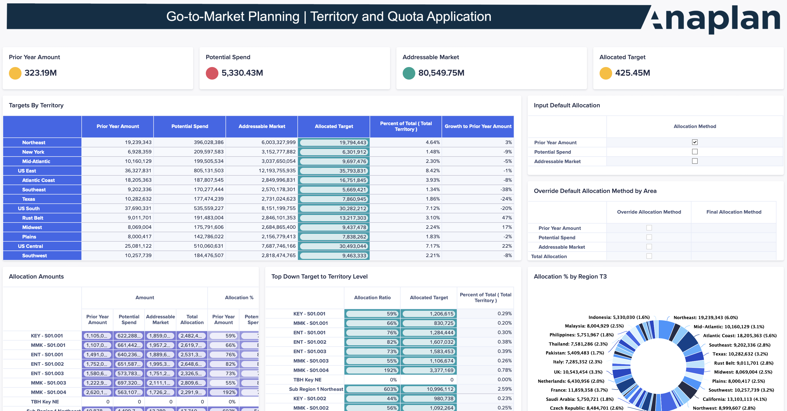
Territory and Quota Planning Application
Straightforward Target Allocation
Input top-down targets as a starting point, leveraging data fed in from the new forecasting application.
Allocate and override targets by team, region, or rep, managing both the planning and current year within the application.
Distribute quotas bottom-up based on account-level data.
Lock targets dynamically with approval workflows, now featuring advanced workflows for top-down approvals.
Review and adjust final quotas before launch
Notes:
Summary

Slide 6
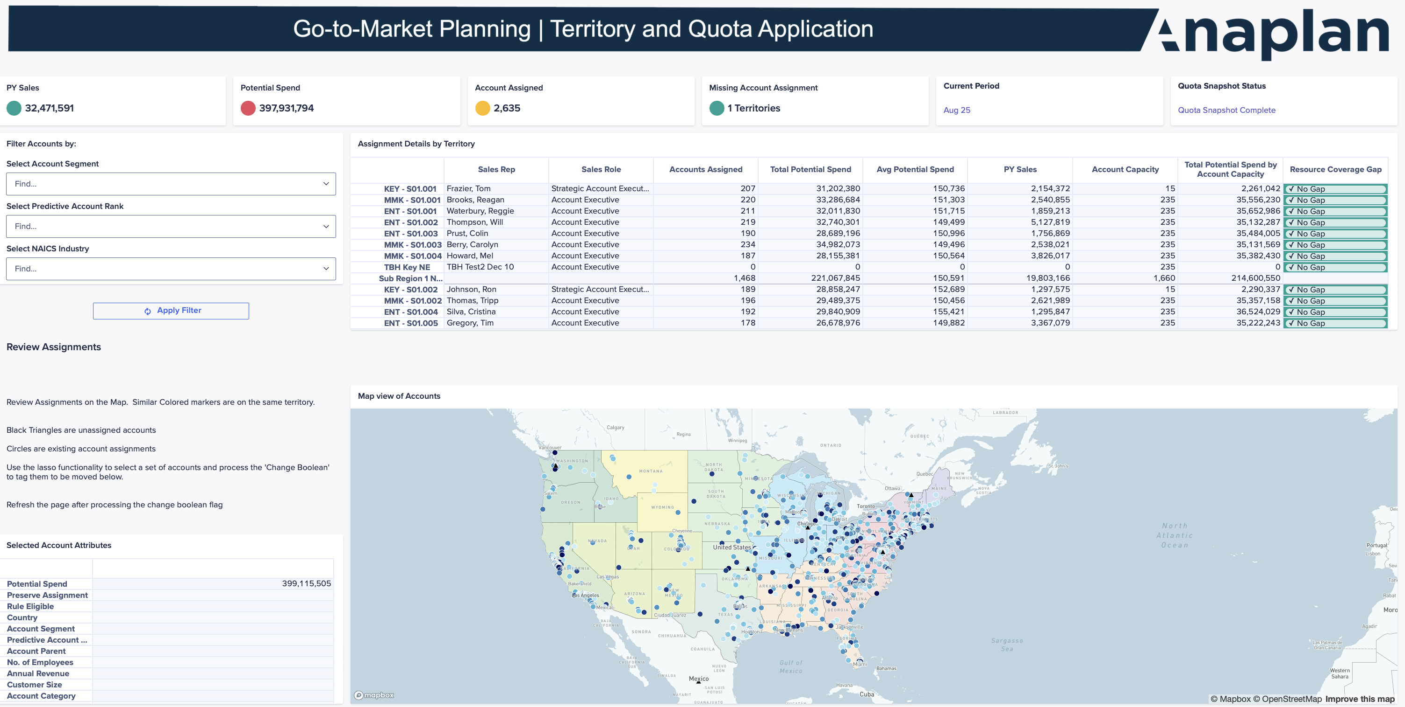
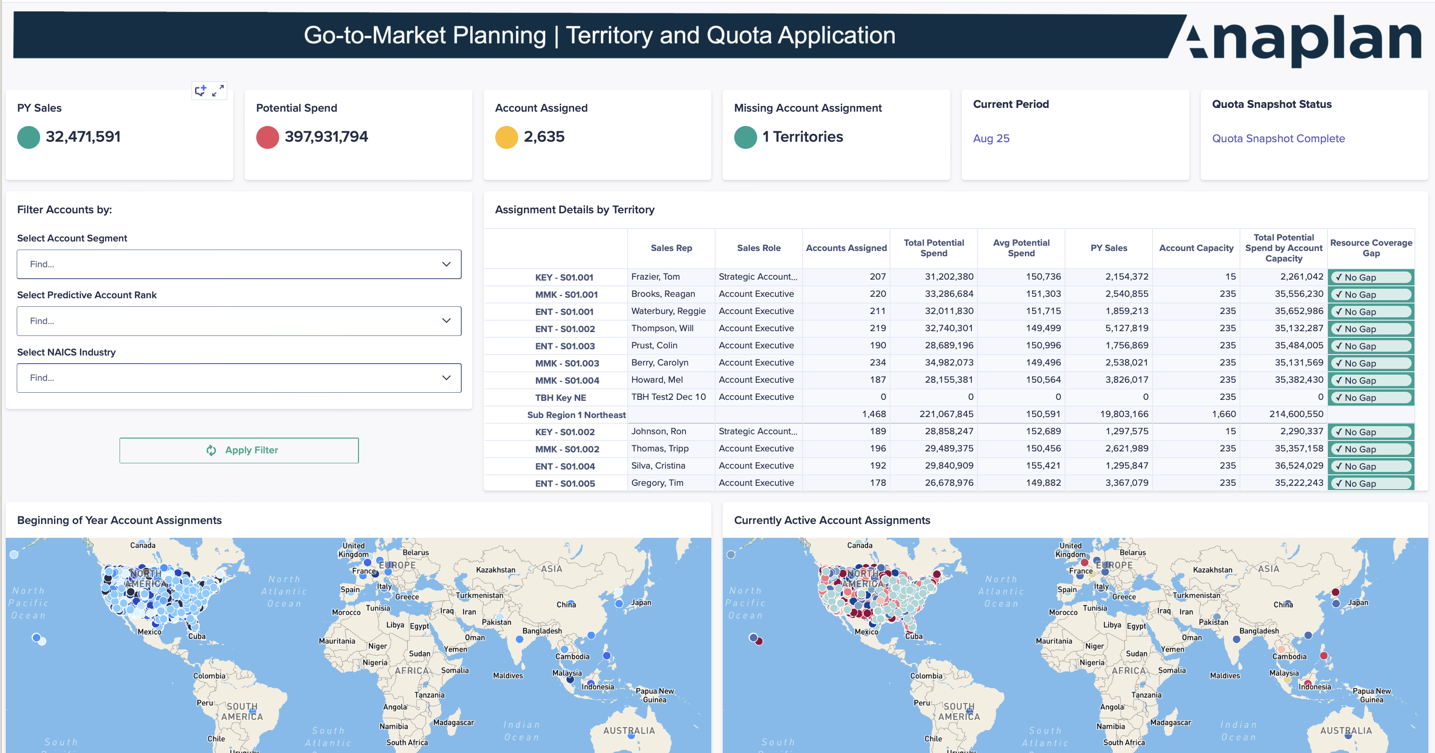
Territory and Quota Planning Application
Smarter Account-to-Territory Assignment
Assign accounts by rules or intuitive selection, now supporting 1:many account to territory assignments with split logic.
Support zip-code logic with geo-mapping tools, available for both planning and current year.
Model redistribution scenarios to balance workload.
1:many assign reps, overlays, and managers across multiple territories or regions.
Evaluate impact of account reassignment on quotas and targets.
Quickly reassign accounts as strategy evolves, with what-if scenarios in the planning year.
Notes:
Summary

Slide 7
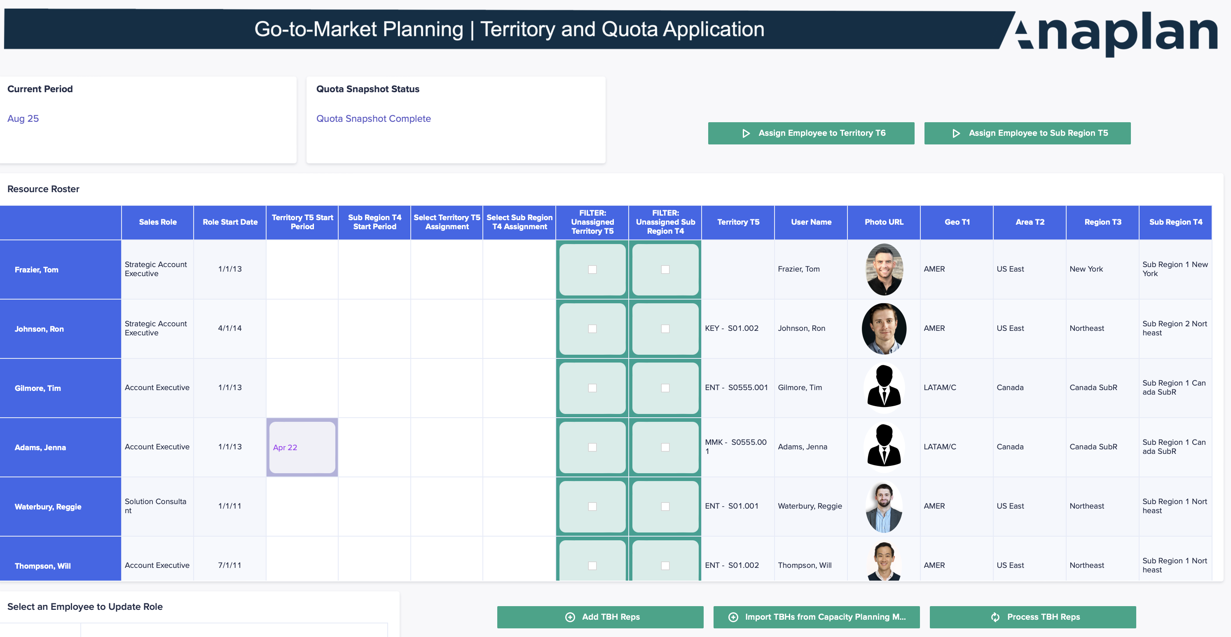
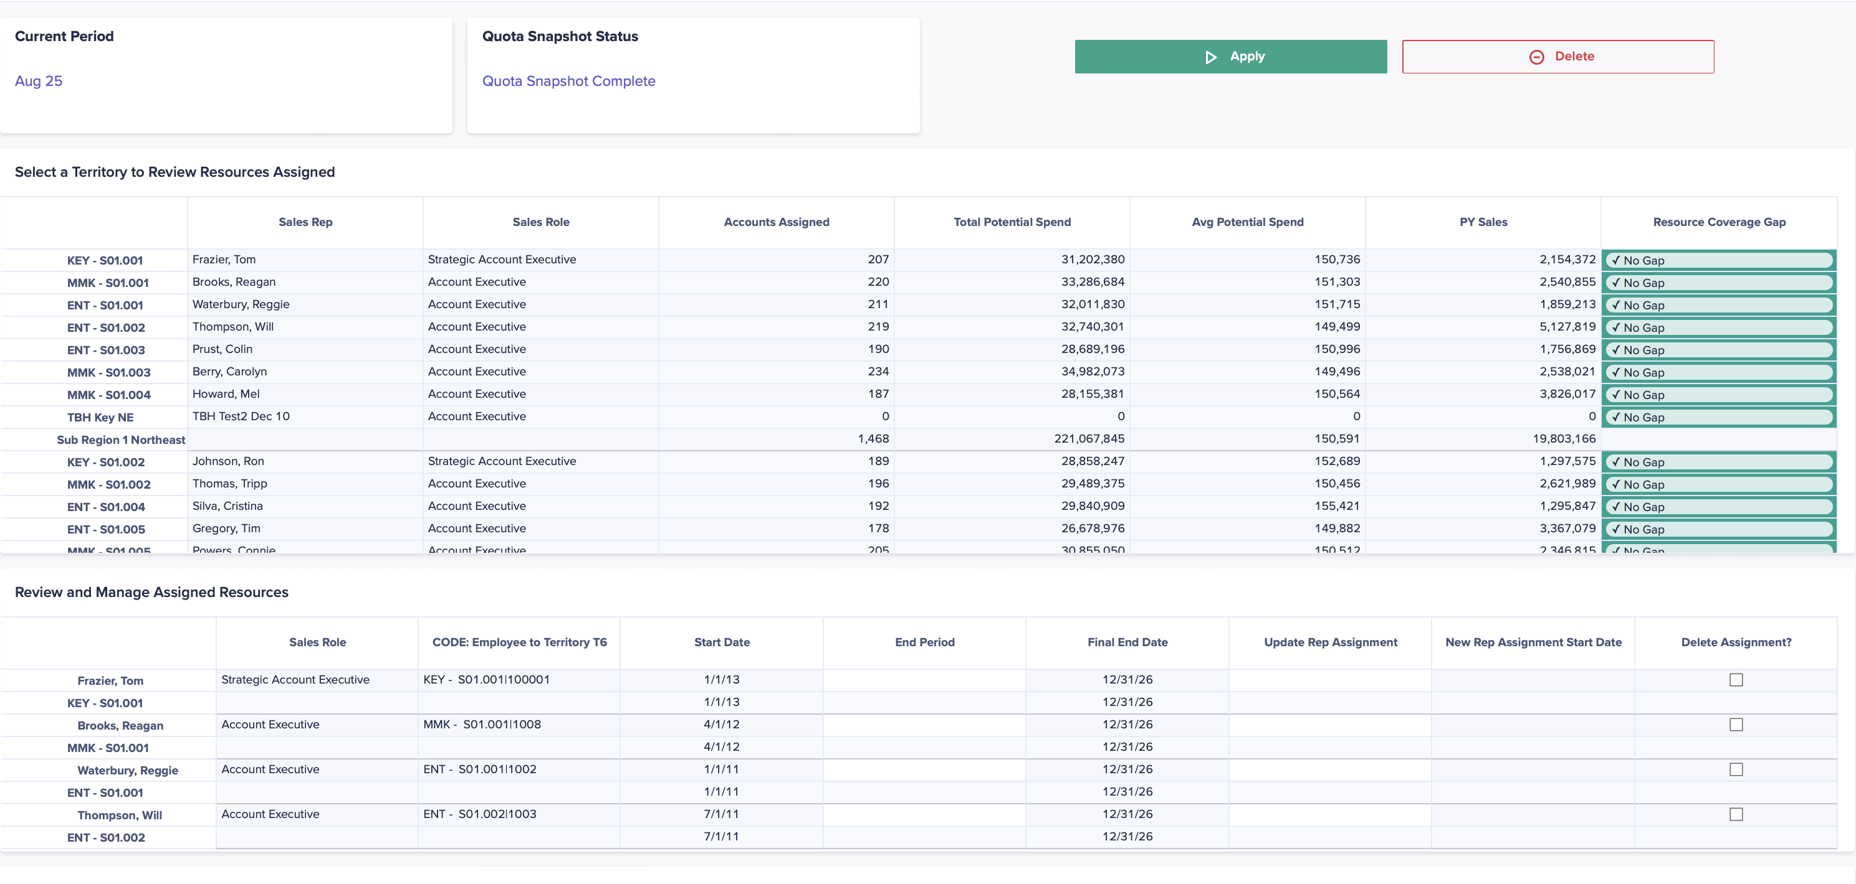
Territory and Quota Planning Application
Simple Rep-to-Territory Assignment
Assign direct sellers and overlays with role-based logic, now supporting 1:many and many:1 resource to territory assignments
Manage rep changes with effective dating and temporary assignments
Track active reps and view historical assignments by month
Quickly assign or reassign reps with start and end dates
Identify and allocate unassigned reps to open territories
Model rep transitions and role changes across territories, utilizing the planning territory hierarchy for changes from the current hierarchy.
Notes:
Summary

Slide 8
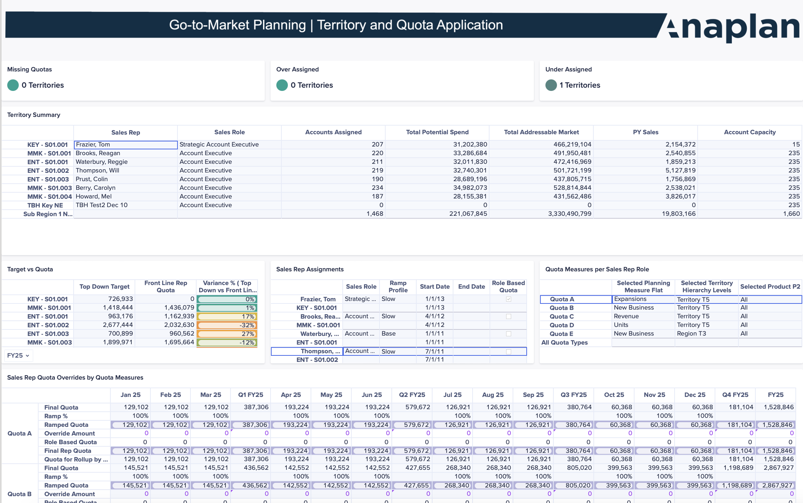
Territory and Quota Planning Application
Quota Assignment with Precision
Assign quotas for direct sellers and overlays roles
Apply ramping and seasonality to rep quota expectations
Set role-specific targets across your sales org
Calculate quotas across configurable dimensions (e.g., hierarchy, role, product)​
Review, approve, and export final quotas
Analyze top-down vs. bottom-up quota allocation, managing the planning year vs. current year in the same application.
Leverage the new forecasting application data for quota calculations and goal setting.
Notes:
Summary

Slide 9
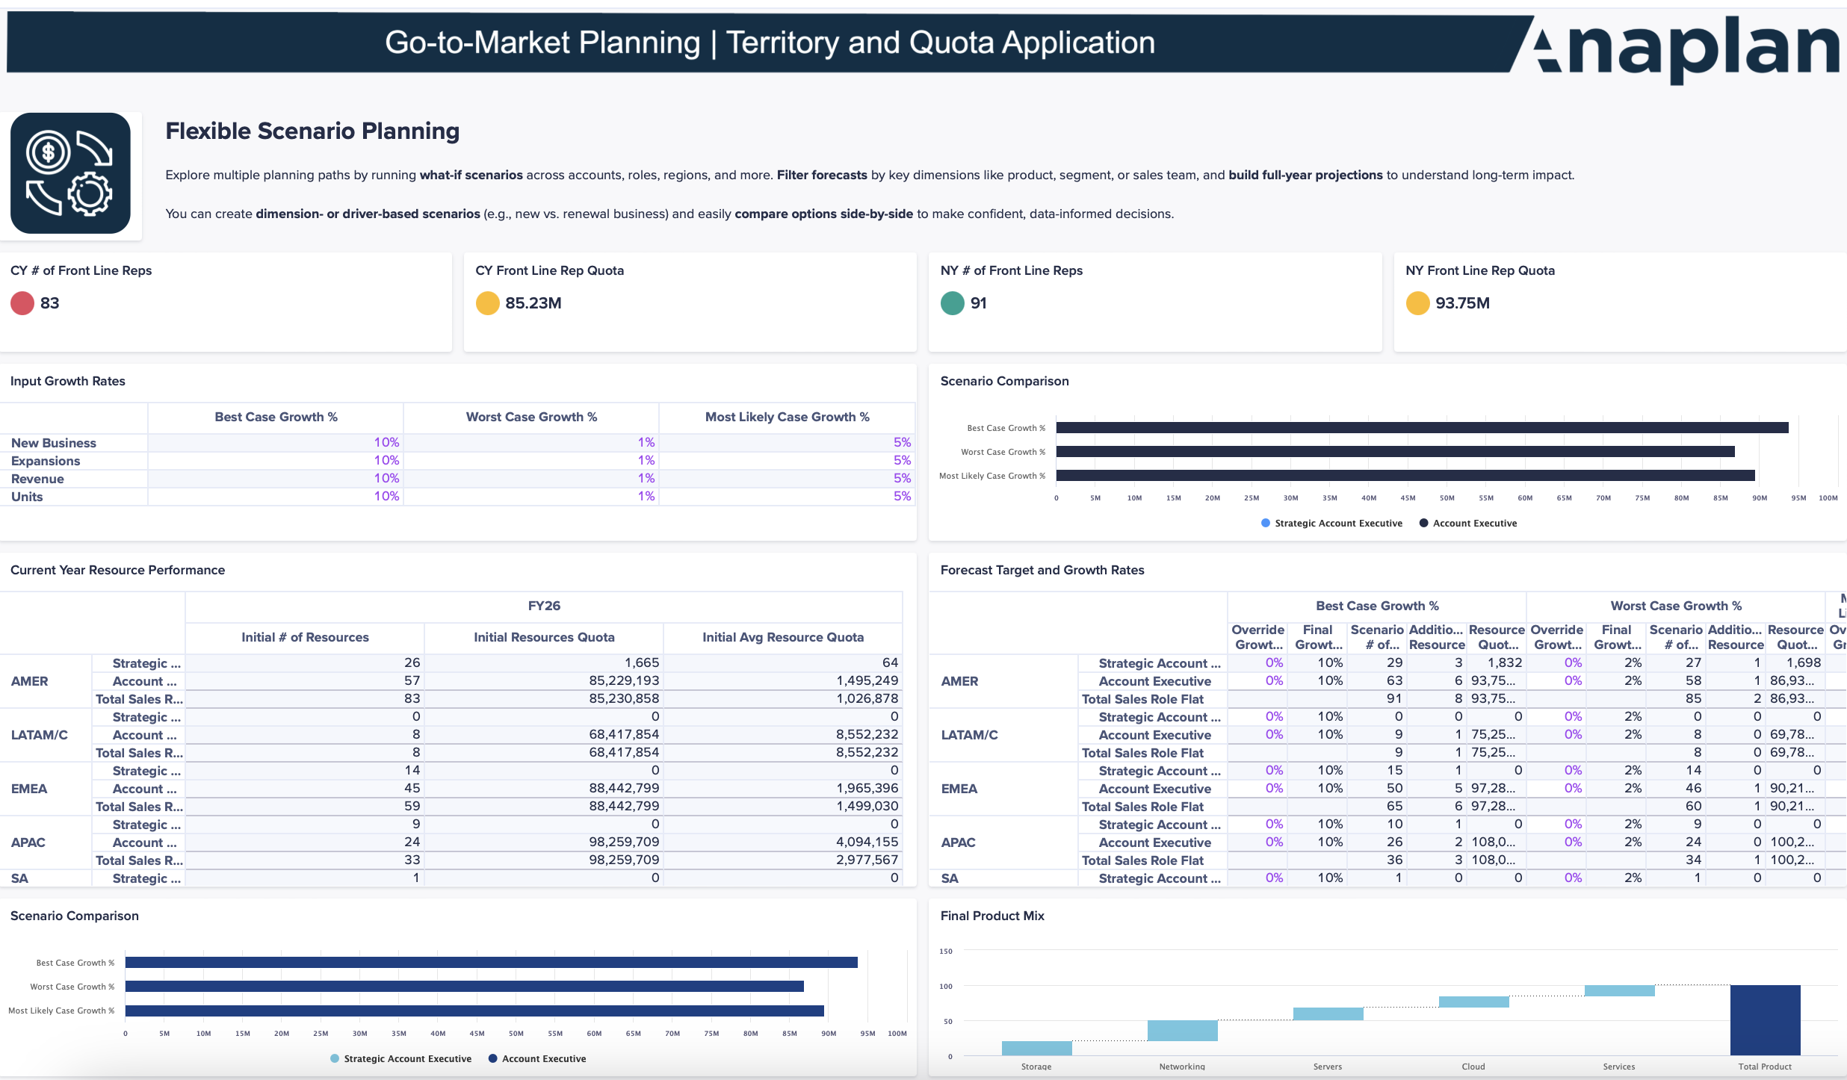
Territory and Quota Planning Application
Flexible Scenario Planning
Run what-if scenarios across accounts, roles, and regions for the planning year
Plan full-year projections and growth paths, including modeling based on a planning territory different from the current territory hierarchy.
Build dimension-based plans (e.g., segment, product, role)
Create driver-based scenarios (e.g., new vs. renewal)
Compare scenarios to guide strategic decisions, supporting 1:many account assignments and 1:many resource assignments.
Notes:
Summary

Slide 10

Anaplan Territory and Quota Planning Applications – Summary
Target Allocations
Quota Assignment
  Input, adjust, and override sales targets (top-down/bottom-up), using forecasting application data
  Lock targets dynamically using advanced top-down approval workflows
  Conduct final reviews while managing the planning and current years concurrently
  Assign quotas directly to reps and overlays, or use role-based targets
  Allocate quotas with ramping, seasonality, and flexible dimensions (e.g., hierarchy, role, product line)
  Compare top-down vs. bottom-up quota allocations, managing the planning vs. current year
  Approve and export finalized assignments
Territory and Quota Planning Application
Account-to-Territory Assignment
Scenario Planning
  Assign accounts by rules, supporting 1:many assignments with split logic
  Model redistribution scenarios
  Support zip-code planning with geo-mapping
  Assign multiple territories to a single rep as needed
  Run what-if scenarios available for every functionality in the planning year
  Model full-year projections and growth strategies using the planning territory hierarchy
  Compare multiple scenarios, supporting new resource and account assignment complexity
Rep-to-Territory Assignment
  Assign and update reps, overlays, and managers by role, supporting 1:many and many:1 assignments
  Manage temporary assignments and role transitions with effective dates
  View and allocate unassigned reps for proper coverage
  Create territory hierarchies based on sales team relationships

